Slide 1
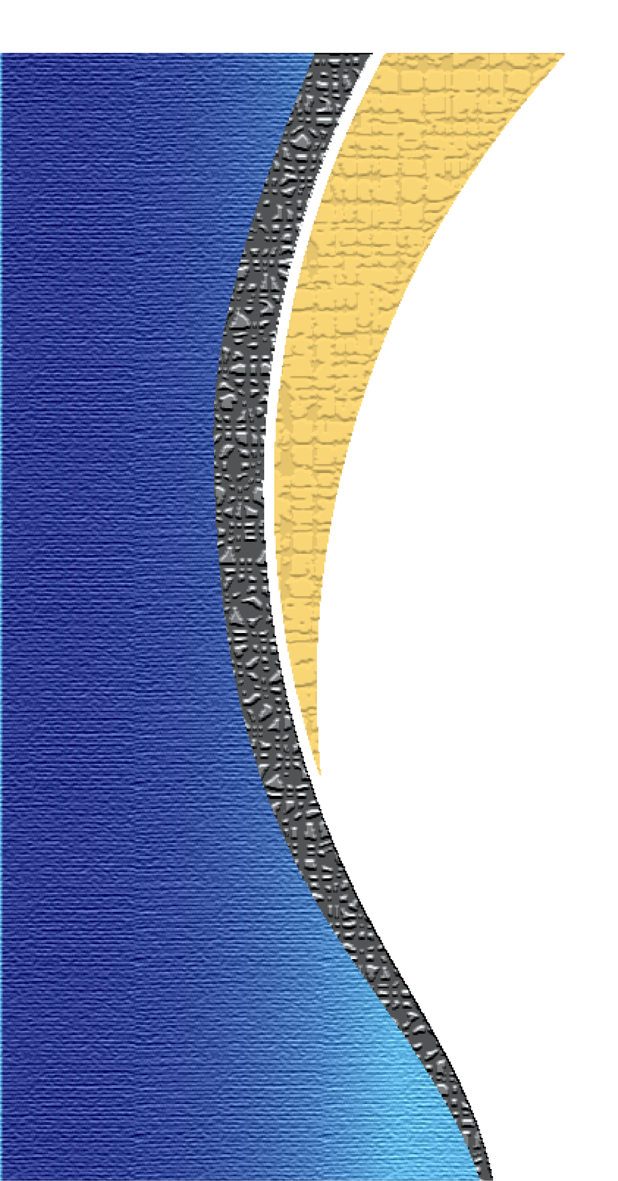
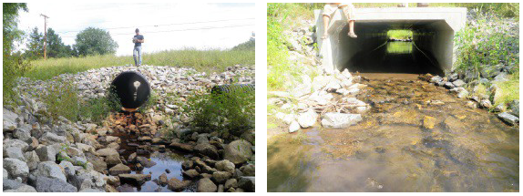
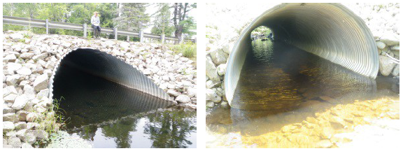
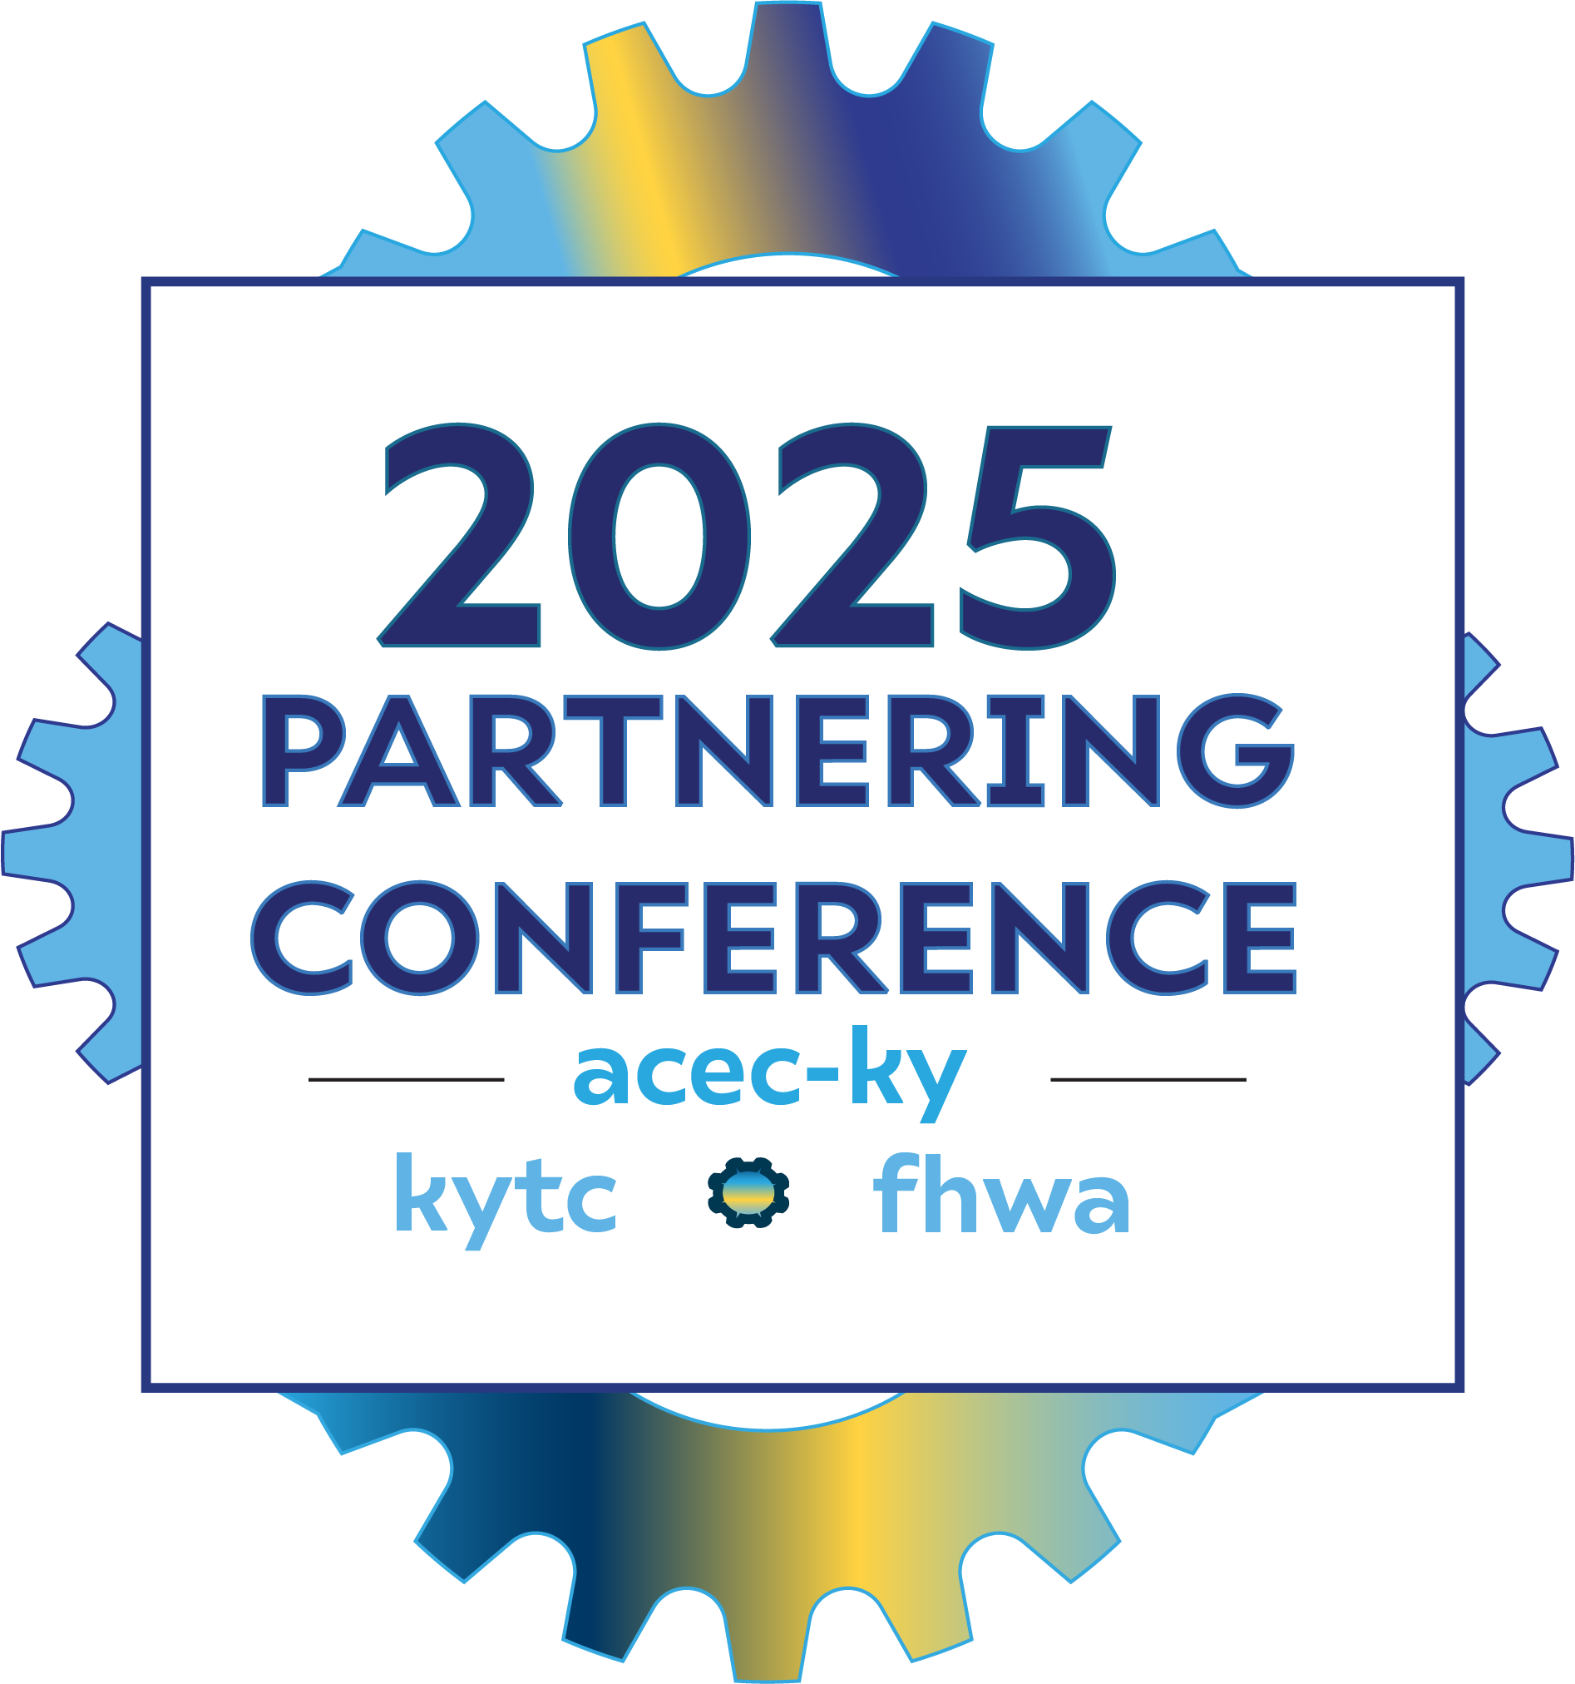
Perched Culvert Structural, Maintenance, Environmental Issues
Southeast Aquatic Resource Partnership (SARP)
Nathan Click

Slide 2
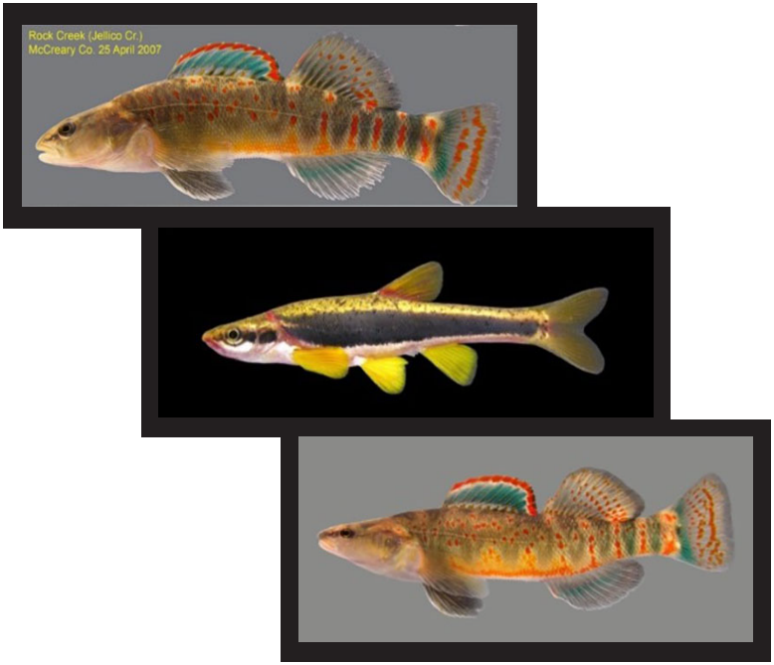
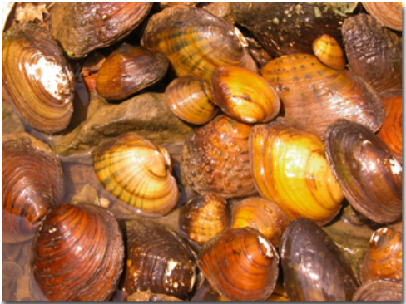
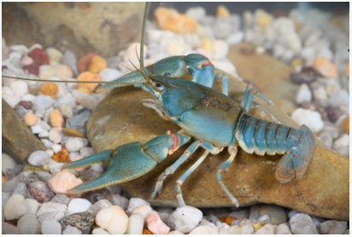
Environmental/Biological Setting
The southeastern United States contains some of the most biologically, recreationally, and commercially
important aquatic resources in the nation

Slide 3

History of SARP
Regrettably, the quality and quantity of these spectacular and valuable aquatic resources are in decline; this led to the formation of the Southeast Aquatic Resources Partnership (SARP) in 2001; SARP works to conserve habitat for at- risk, game, and recreationally important fish for freshwater, brackish, and marine species across the Southeast
SARP was incorporated into the National Fish Habitat Partnership (NFHP) in 2007; representatives from 15 state and territorial fish and wildlife agencies, multiple federal agencies, and numerous business and nongovernmental organizations (NGOs) now comprise SARP; the mission of SARP is to “with partners, protect, conserve, and restore aquatic resources including habitats throughout the Southeast for the continuing benefit, use and enjoyment of the American people”

Slide 4
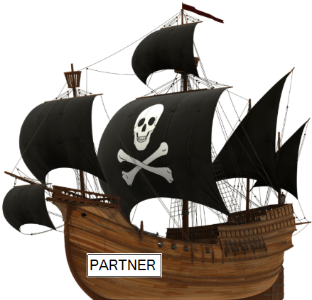
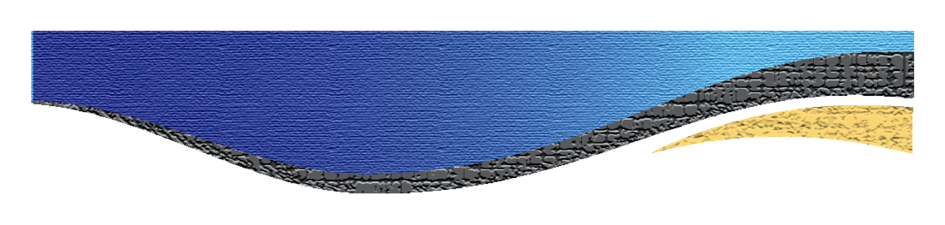
SARP
SARP uses four different programs to conserve the Southeast’s valuable aquatic resources as follows:
Restoration Program
Aquatic Connectivity Program
Conservation Planning and Research Program
Coastal Program

Slide 5
Restoration Program
SARP’s largest program, in terms of financial investment, is its Restoration Program
This program seeks to facilitate restoration and enhancement of aquatic and
riparian habitats, provide technical assistance to partners, and secure
funding to support projects
Projects include streambank stabilization, gravel bar enhancement, riparian habitat
restoration, water savings, agricultural best management practices, invasive species
removal, dam removal, culvert removals and replacements, oyster reef restoration,
seagrass bed enhancement, salt marsh restoration, and living shoreline construction
Funding for these projects comes from multiple sources including the NFHP, NMFS,
USFWS, the National Fish and Wildlife Foundation (NFWF), the
U.S. Forest Service (USFS), the U.S. Environmental Protection Agency,
and various environmental foundations

Slide 6
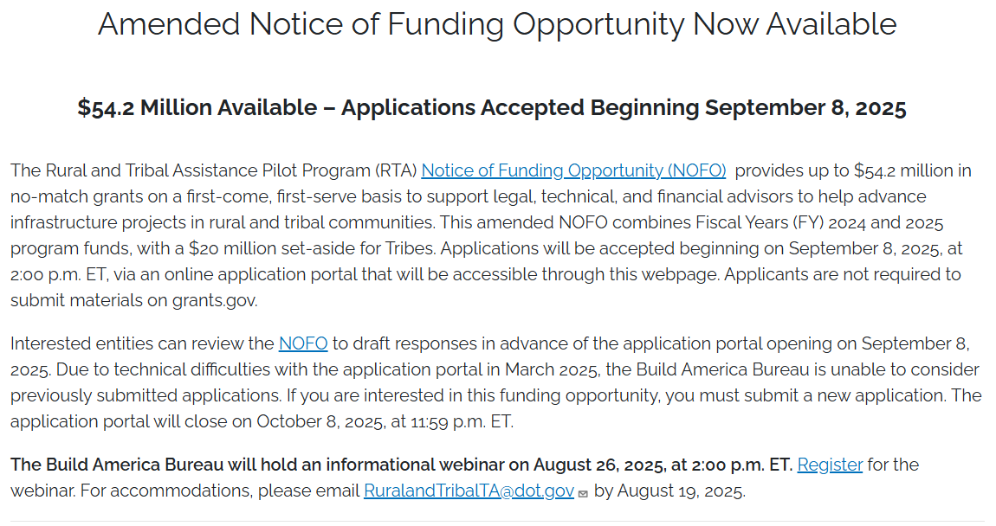
Restoration Program

Slide 7
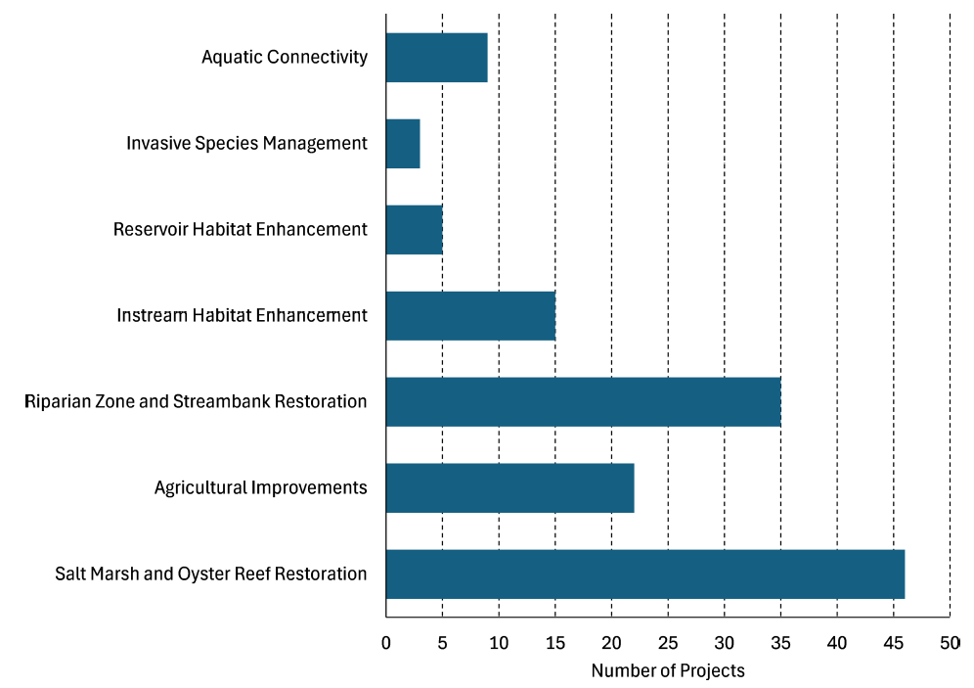
Restoration Program

Slide 8
Aquatic Connectivity Program
Fragmentation of aquatic habitats from man- made barriers is widely recognized as one of the highest priorities for most aquatic species across the landscape
To address this priority, in 2013, SARP initiated its Aquatic Connectivity Program, which focuses on three areas:
mapping manmade aquatic barriers within SARP region
developing a prioritization framework to allow partners to identify the highest priority projects
building a community of practice across the region of resource managers working to restore aquatic connectivity through the initiation of Aquatic Connectivity Teams (ACT)

Slide 9
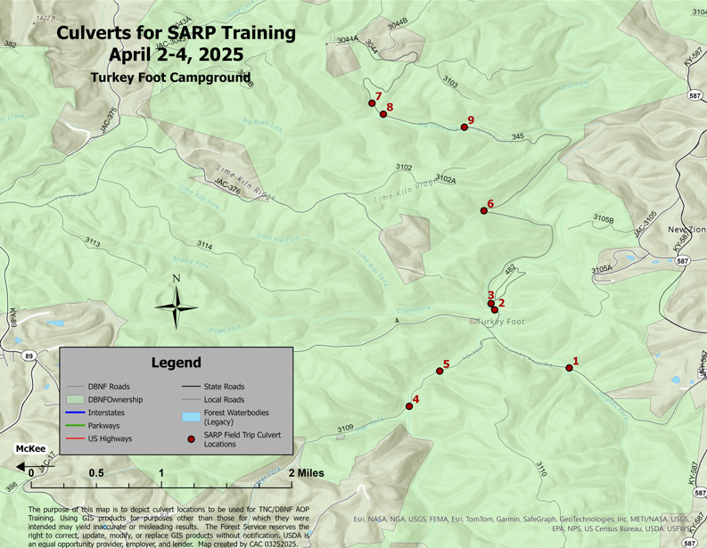
Mapping
Structures

Slide 10
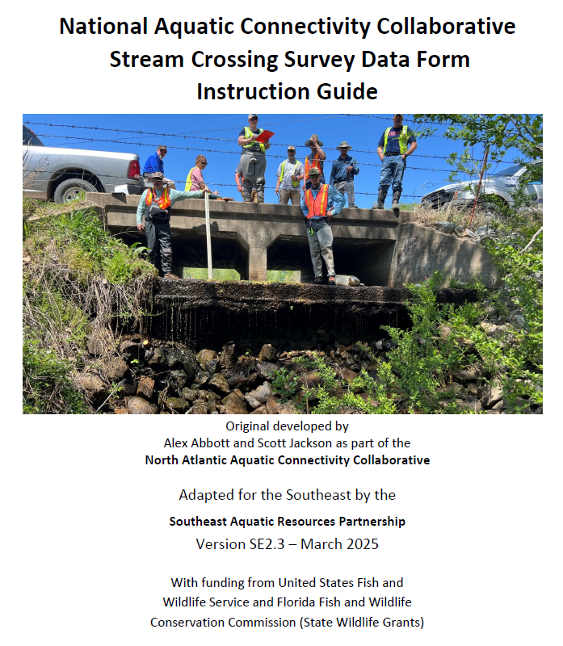
Prioritization Framework
Assessing structures in
mapped areas to identify
high priority structures

Slide 11
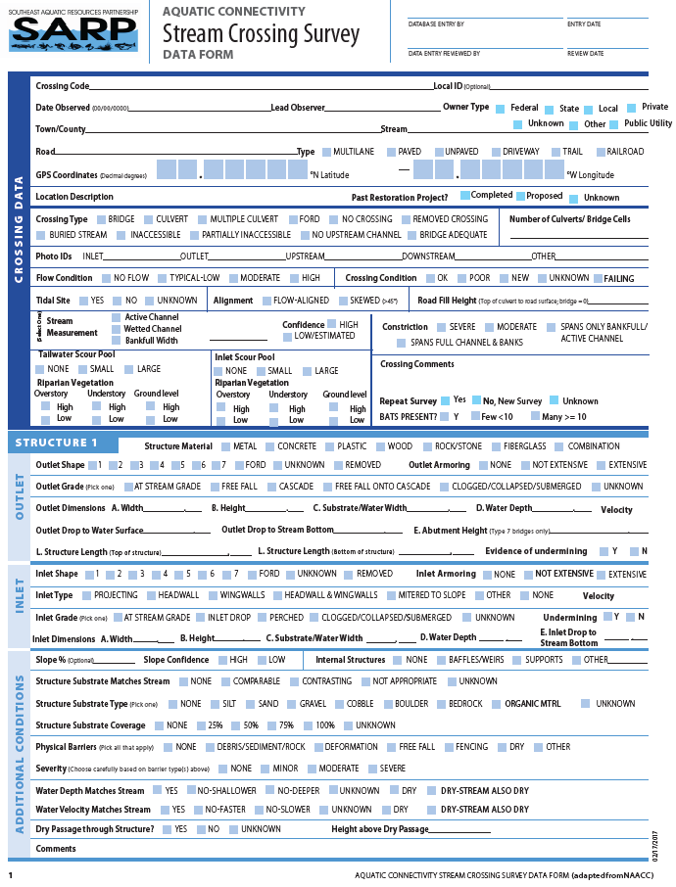
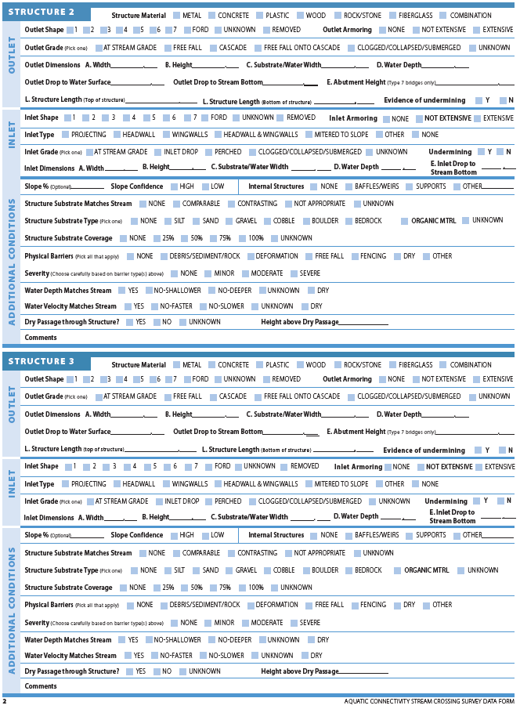
Collecting Data

Slide 12
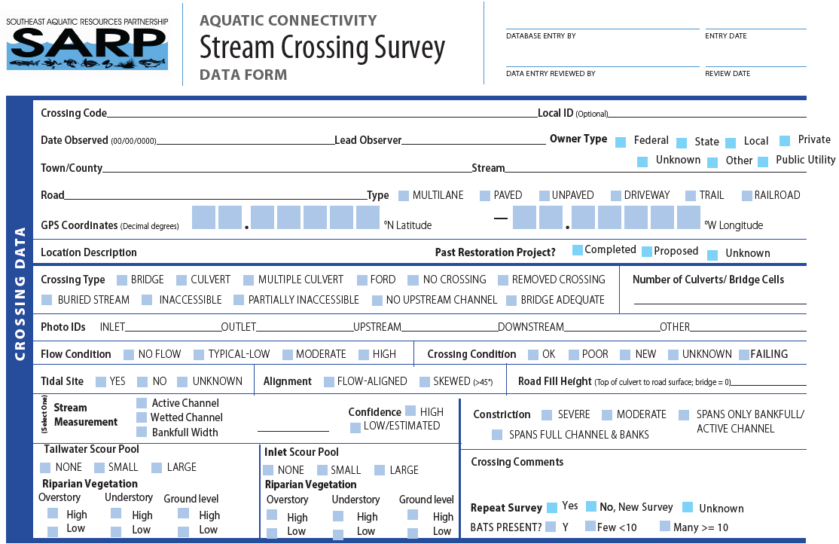
Collecting Data

Slide 13
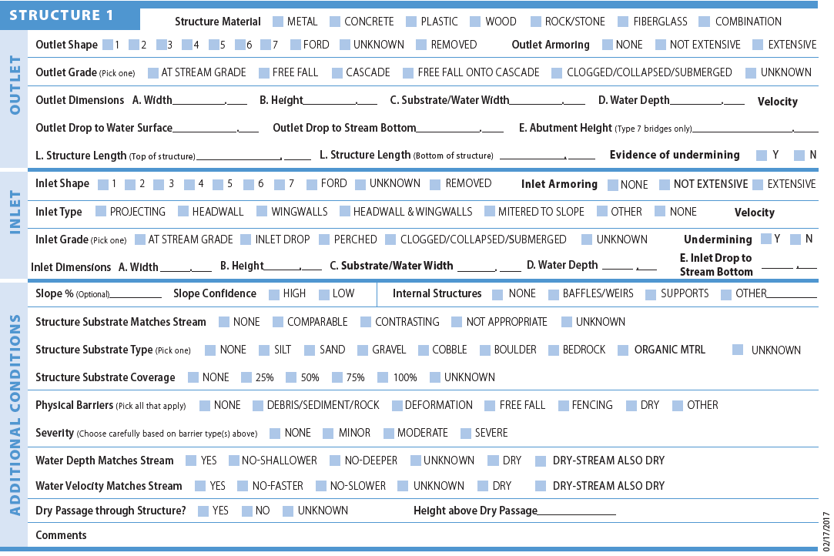
Collecting Data

Slide 14
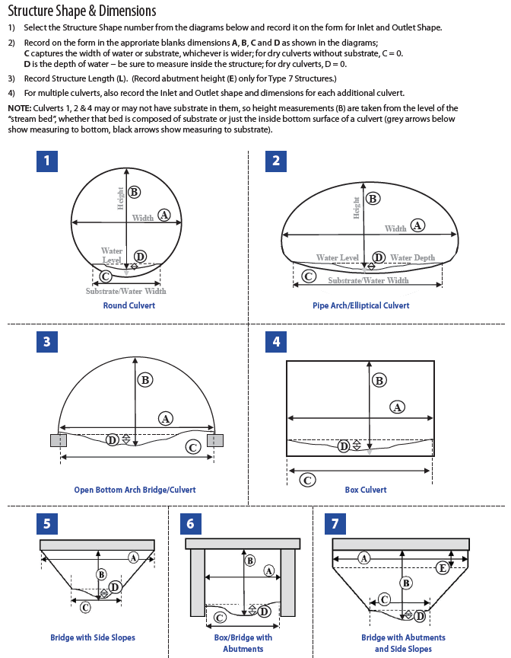
Collecting
Data

Slide 15
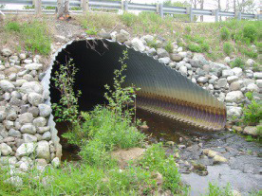
Collecting Data

Slide 16
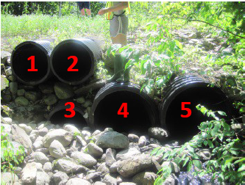
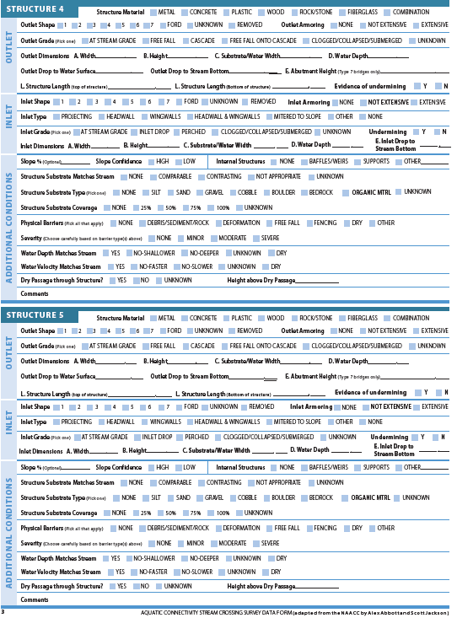
Collecting Data

Slide 17
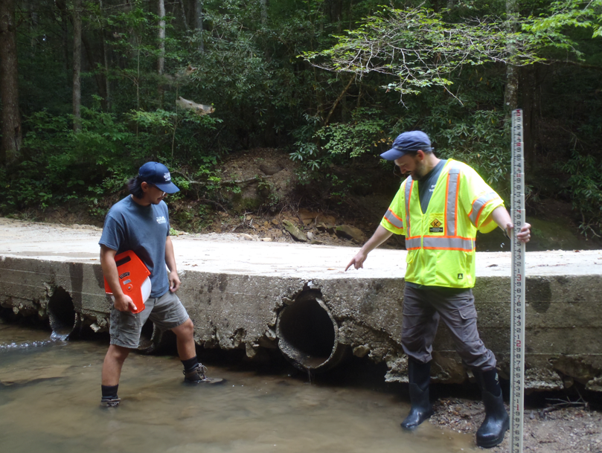
Difficult Situations

Slide 18
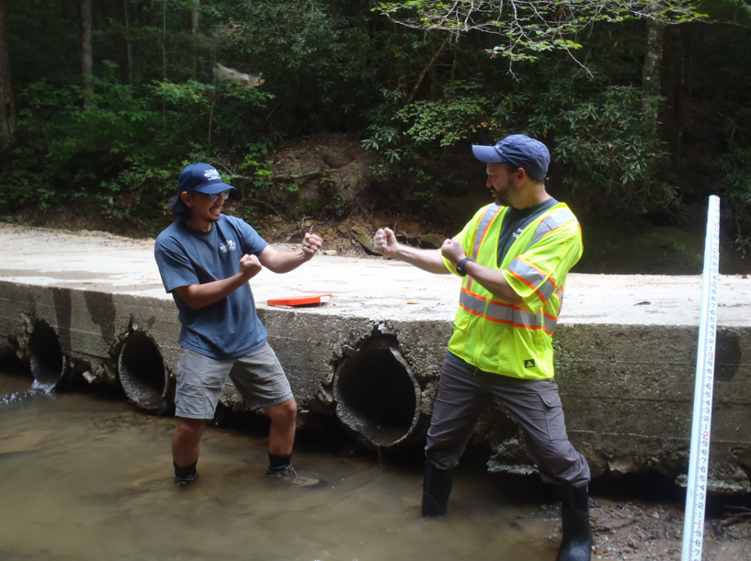
Difficult Situations

Slide 19
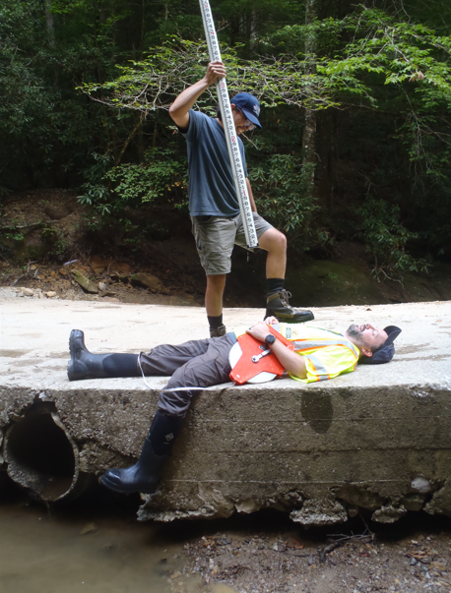
*Disclaimer: This protocol
is in the Beta testing stage
and it is not recommended
outside of the Beta testing
environment *
*Disclaimer: KYTC does not condone violence of any kind*

Slide 20
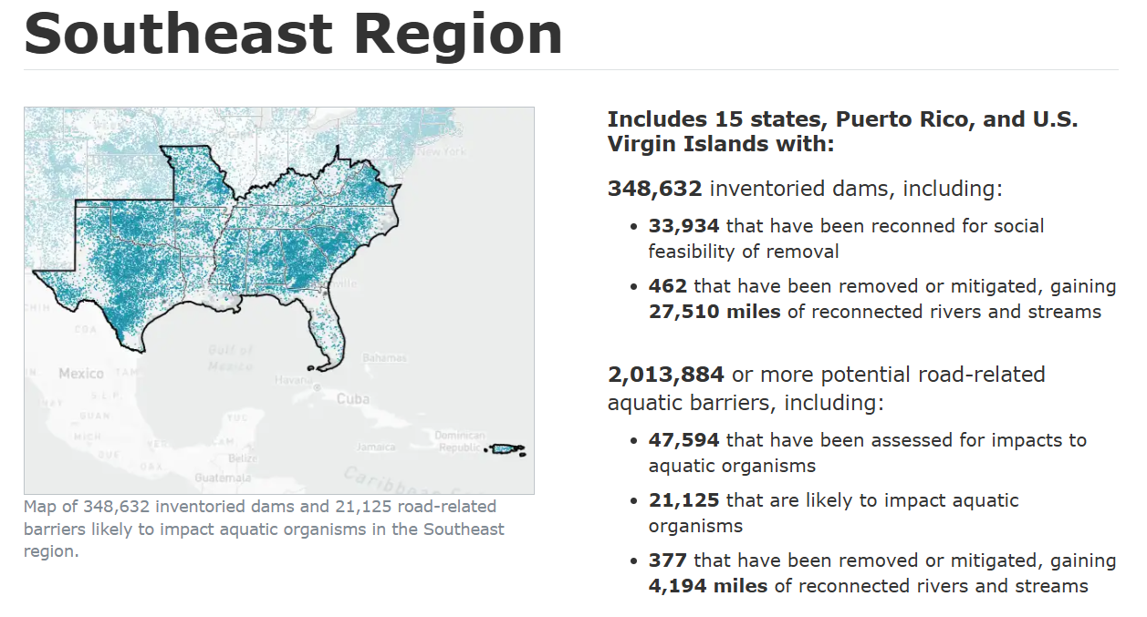
Collecting Data

Slide 21
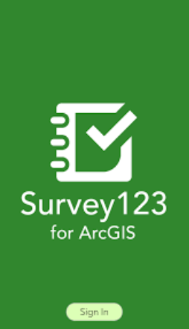
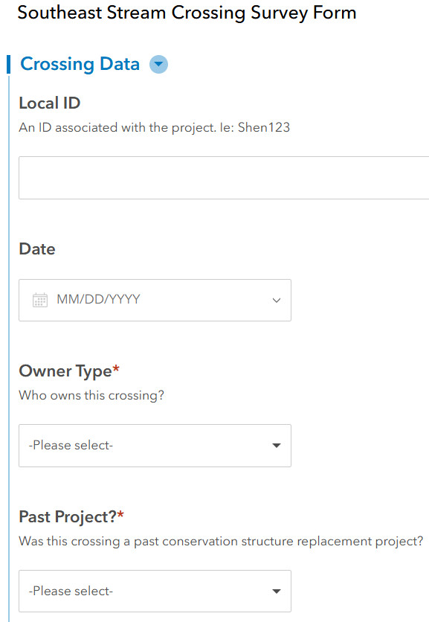
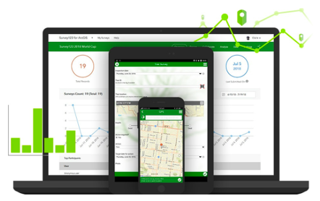
Collecting Data

Slide 22
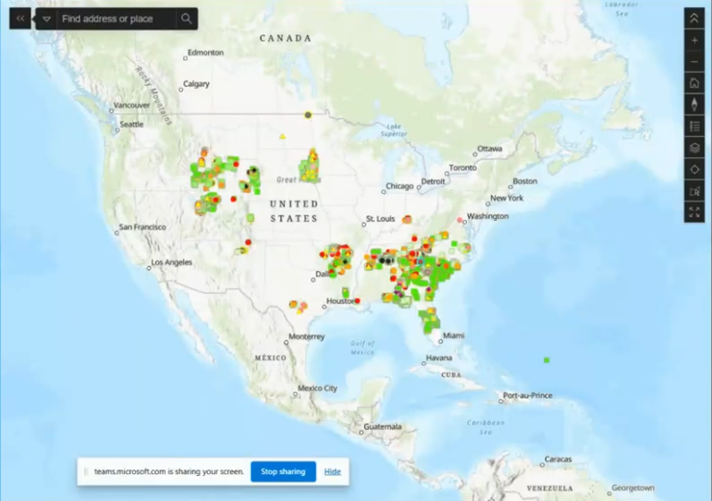
Collecting Data
Survey123 data
Welcome KY!

Slide 23
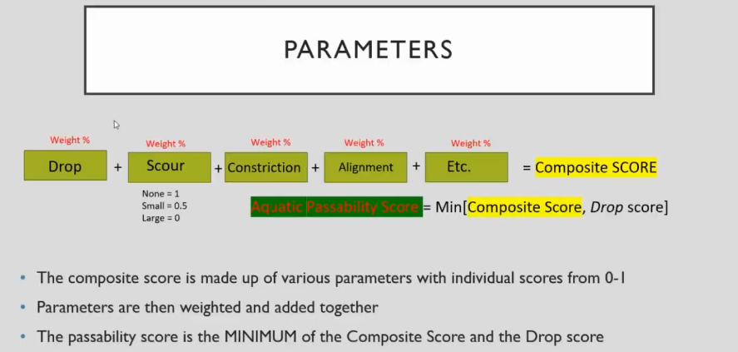
Setting Priorities

Slide 24
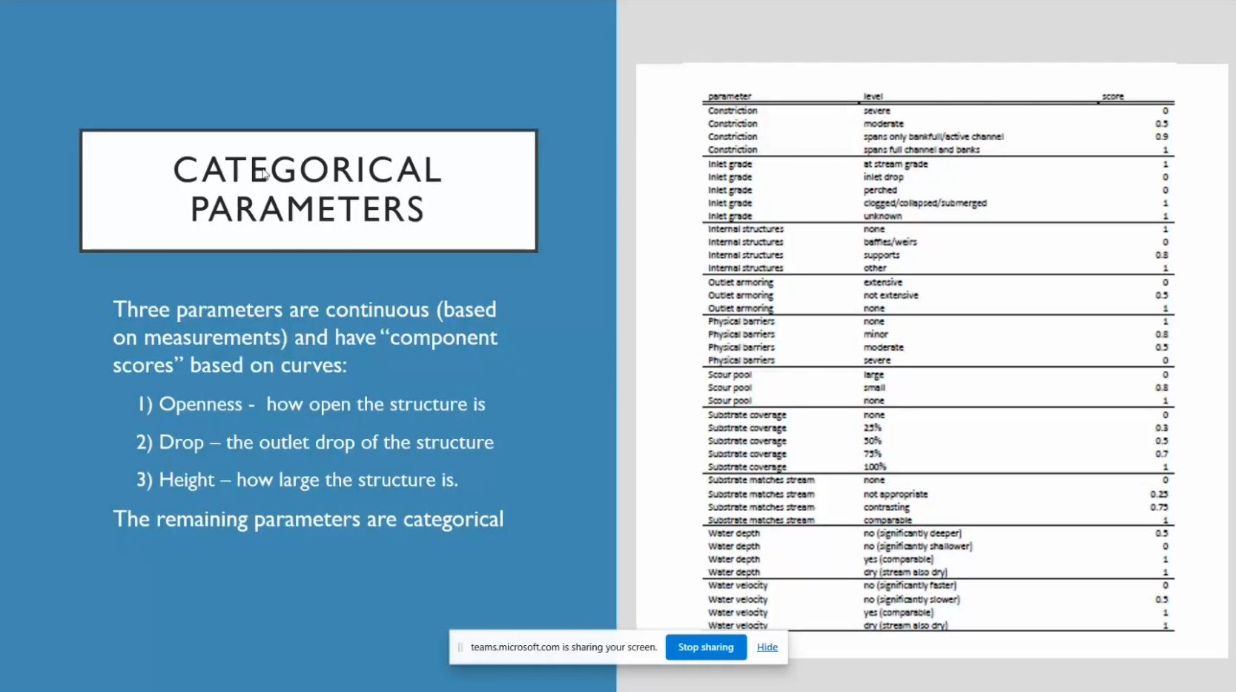
Setting
Priorities

Slide 25
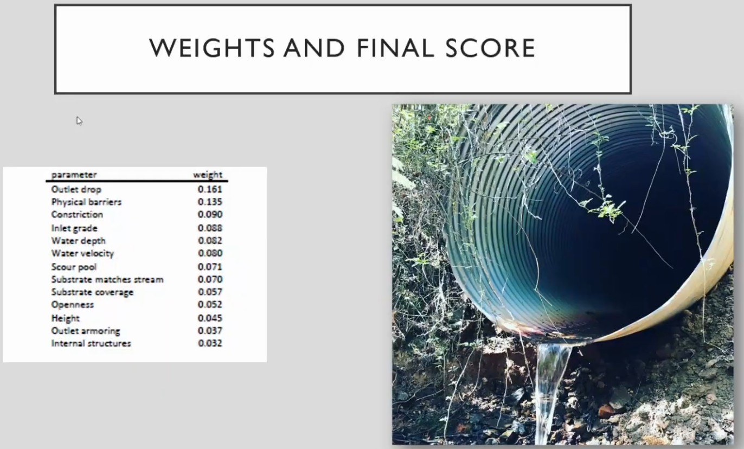
Setting
Priorities

Slide 26
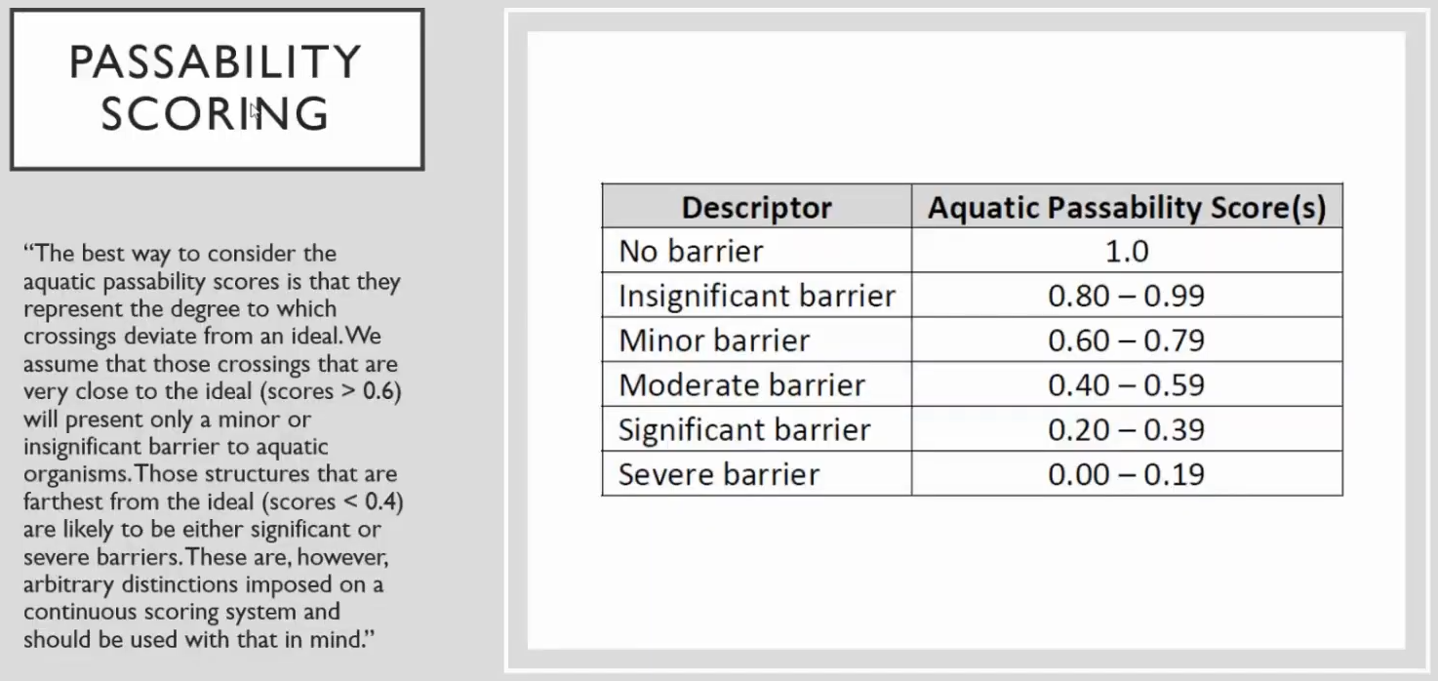
Setting
Priorities

Slide 27
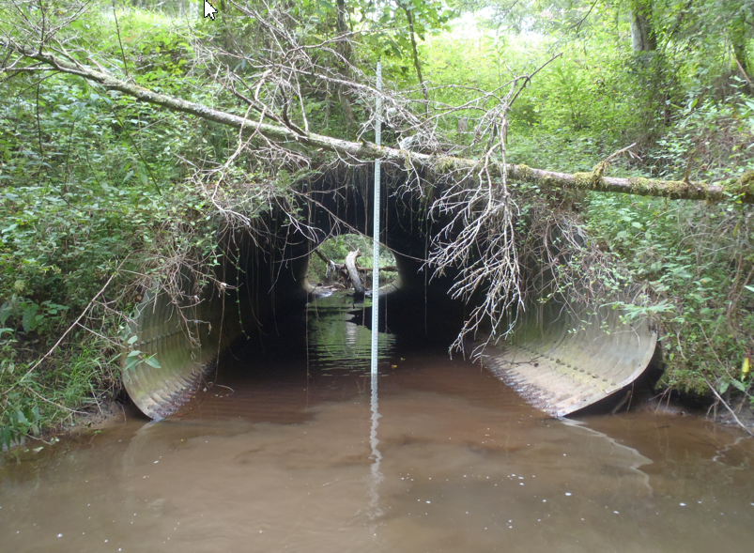
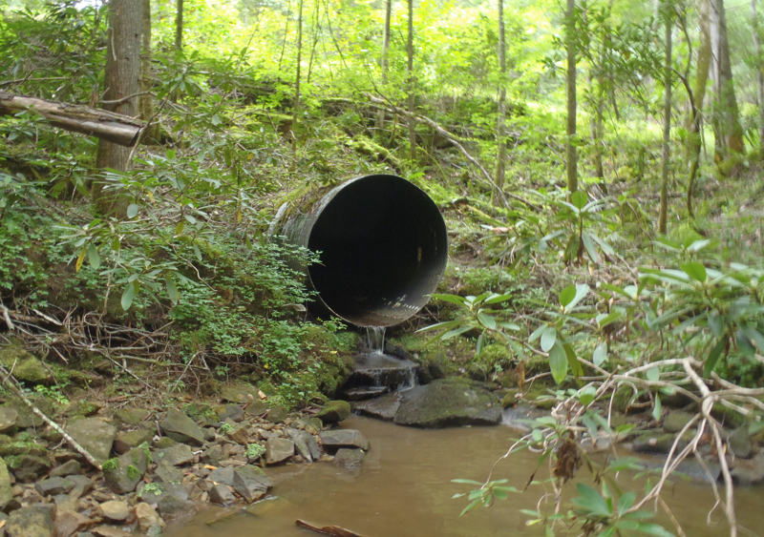
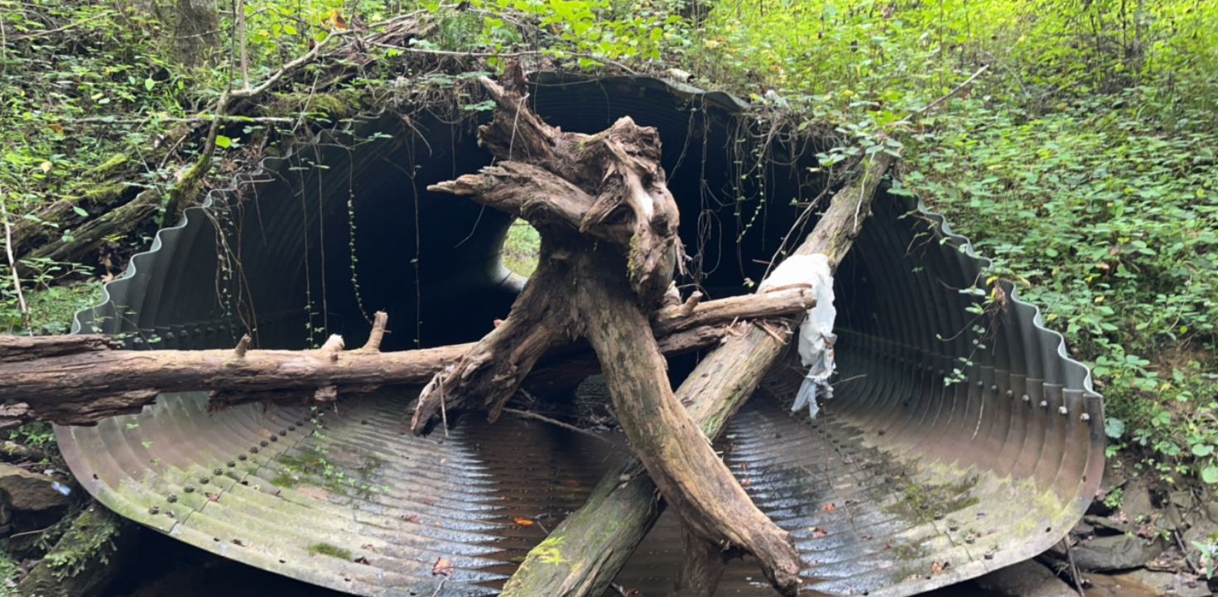
And the score is…
0.02 – severe barrier
0.56 – moderate barrier

Slide 28
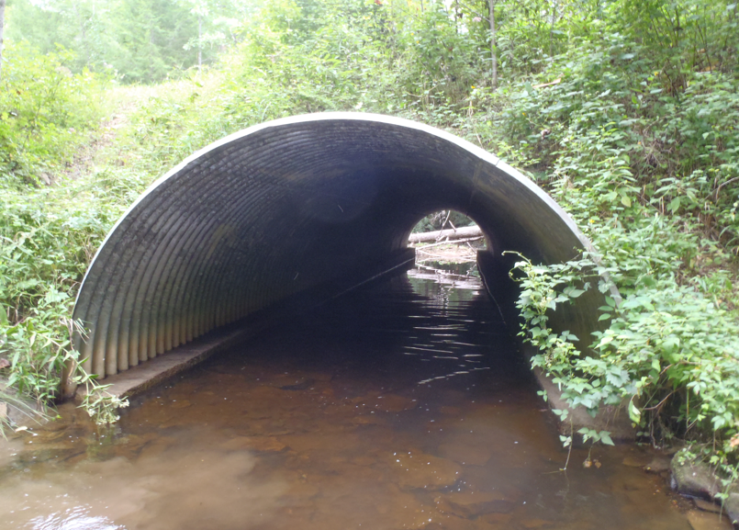
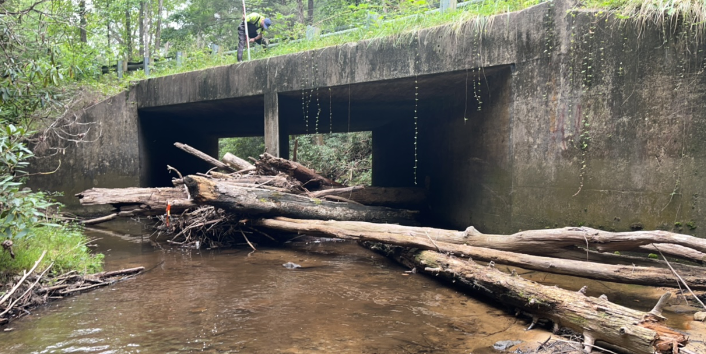
And the score is…
1 – no barrier
0.96 – insignificant barrier

Slide 29
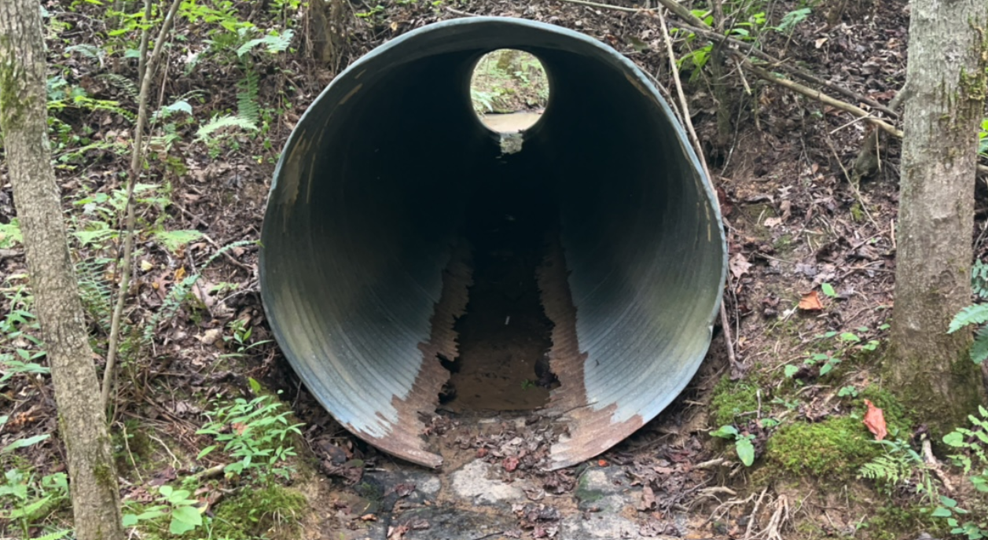
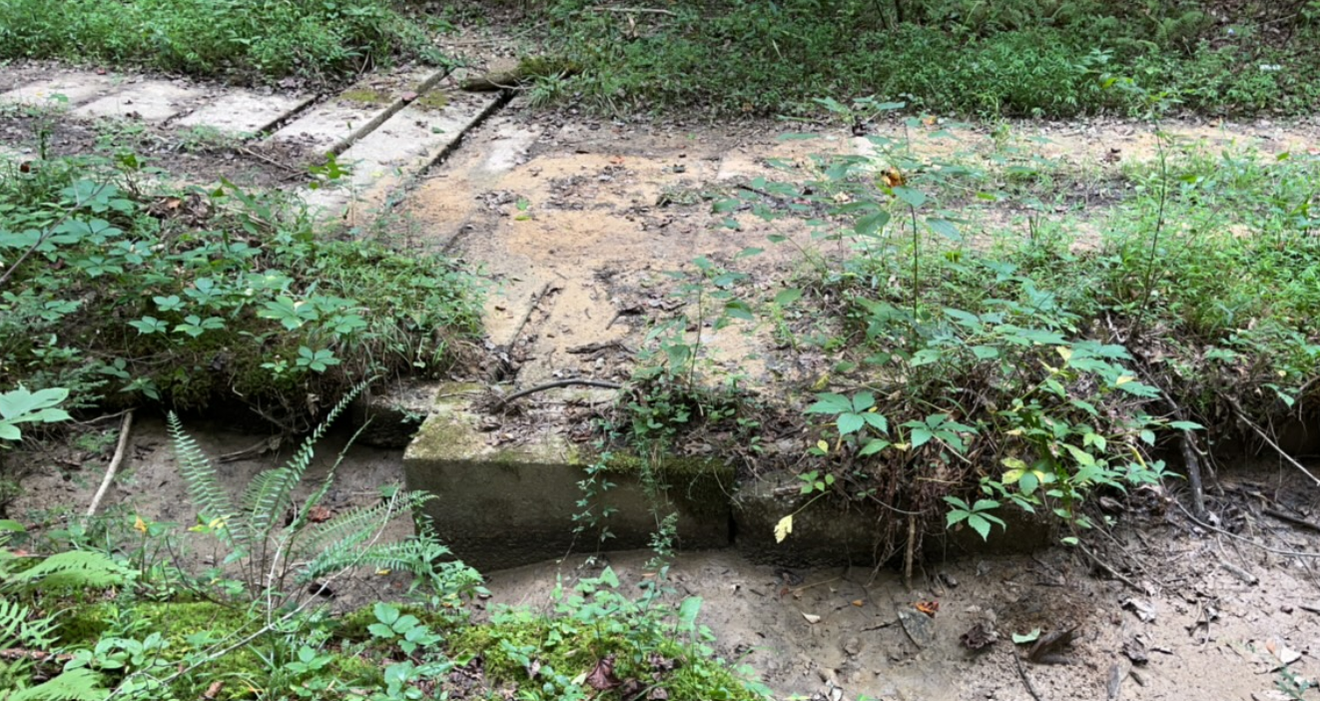
And the score is…
0.70 – minor barrier
0.86 – insignificant barrier

Slide 30
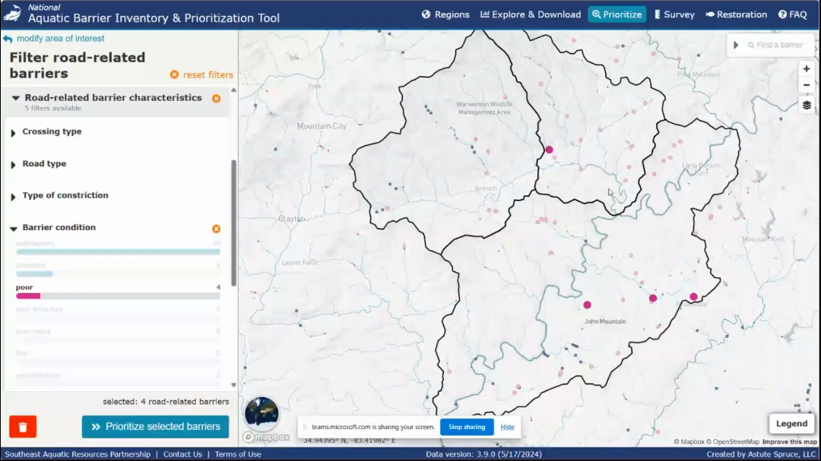
Setting Priorities

Slide 31
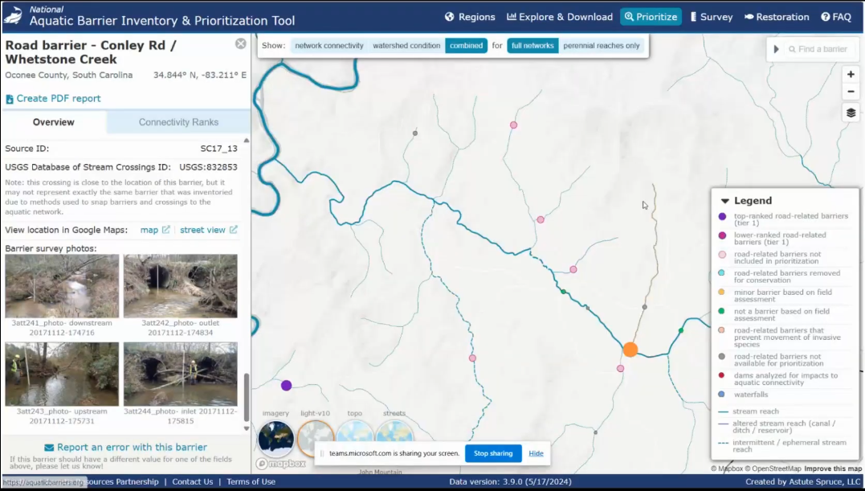
Setting Priorities

Slide 32
Kentucky Aquatic Connectivity Team (KACT)
The mission of the Kentucky Aquatic Connectivity Team (KACT) is to increase aquatic connectivity of the state’s streams and floodplains by assessing, prioritizing, and removing barriers that block the passage of aquatic wildlife, impede ecological functions, and endanger downstream communities
This work plan focuses on barrier inventory, project implementation, regulatory streamlining, communication and outreach, biological monitoring, and funding around aquatic organism passage in Kentucky; partners in the KACT will work together to accomplish these goals through 2026

Slide 33
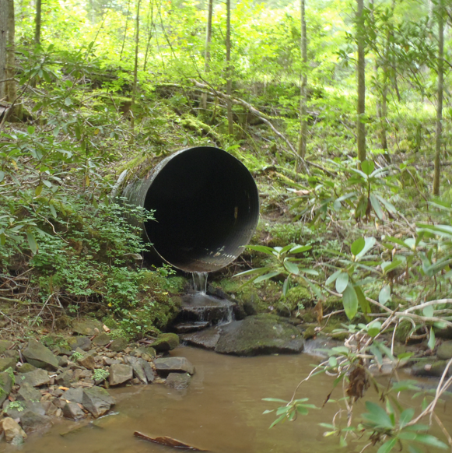
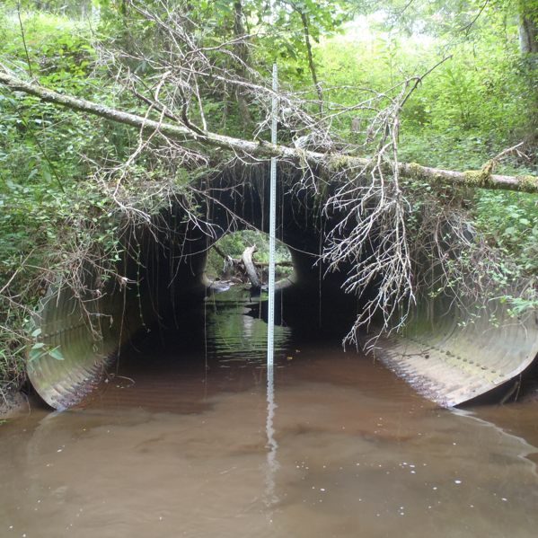
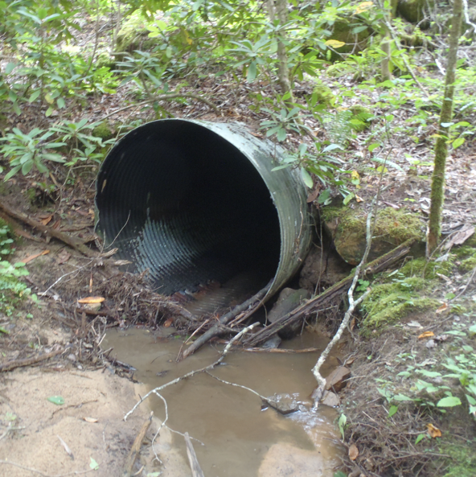
Kentucky Aquatic Connectivity Team (KACT)
Goal 1 - Road Stream Crossing Inventory and Replacement/Removal
Identify high priority watersheds to complete road-stream crossing inventory, pursue funding for high priority projects and compile information on best practices for road-stream crossing design

Slide 34
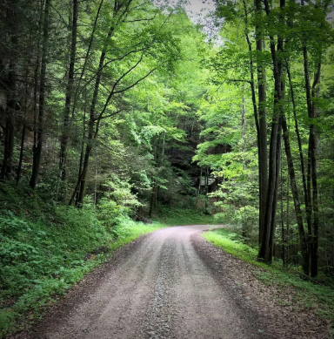
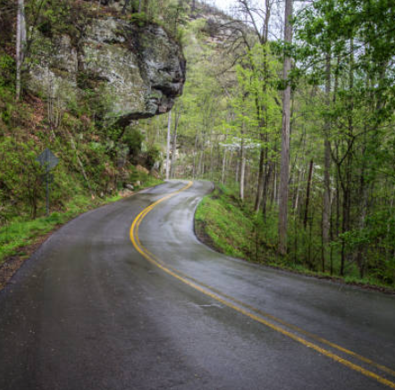

Kentucky Aquatic Connectivity Team (KACT)
~ 475 structures on State Roads within DBNF
~ 298 structures on County Roads within DBNF

Slide 35
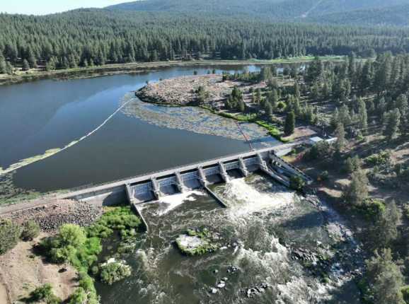
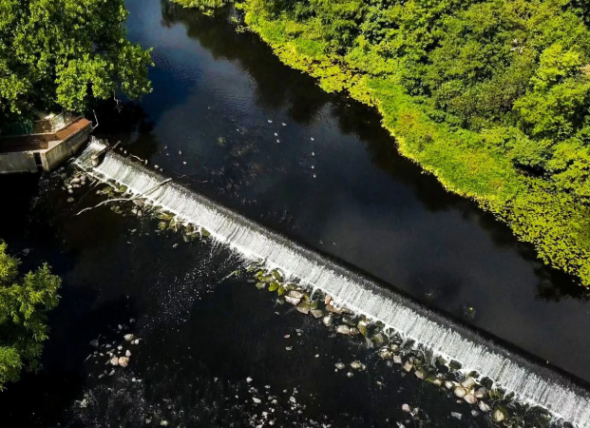
Kentucky Aquatic Connectivity Team (KACT)
Goal 2 - Dam Inventory and Project Management
Perform dam inventory for the state of KY and pursue project management training

Slide 36
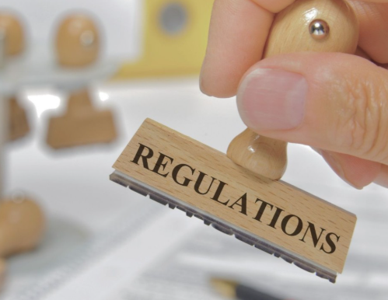

Kentucky Aquatic Connectivity Team (KACT)
Goal 3- Regulatory
Develop targeted support and pressure on policies and agencies to streamline procedures for aquatic connectivity

Slide 37


Kentucky Aquatic Connectivity Team (KACT)
Goal 4 - Community Engagement
Improve outreach, communication, and education so that dam removal, culvert replacement, and stream crossing improvement practices are better understood and accepted among professionals and private citizens and more commonly used across the state

Slide 38


Kentucky Aquatic Connectivity Team (KACT)
Goal 5- Research and Monitoring
Bolster monitoring efforts on barrier removal projects and activate partners in academia

Slide 39

KACT
Mill Branch – Knox County
Bottomless culvert in historic
KAD stream
KYTC will handle ESA
Other partners include
USFWS, NRCS, TNC, and
UGA

Slide 40

Conservation Planning and Research Program
SARP’s Conservation Planning and Research Program is designed to develop and use
the best- available science to guide conservation actions
SARP’s most recent planning activity involves the identification of priority watersheds
to maximize the conservation of the aquatic Regional Species of Greatest Conservation
Need in the Southeast; this will be accomplished by developing habitat suitability models
for as many of the 587 species, then rank watersheds by the number of species for which
they contain suitable habitat

Slide 41

Conservation Planning and Research Program
SARP coordinated the development of the
Native Black Bass Initiative (NBBI)
Formed in 2010, the Southeast Native Black Bass Initiative
is made up of local, state and federal agencies, universities,
non-profit organizations and businesses from across the region
who have come together in partnership with the National Fish
and Wildlife Foundation to protect and preserve native black
bass species in the Southeastern United States; the Initiative
plans to address all species of native black bass in the
Southeast, with initial conservation actions focused on three
species with critical conservation needs (Guadalupe bass,
redeye bass, and shoal bass)

Slide 42

Conservation Planning and Research Program
SARP recently partnered with Clemson University to determine the swimming ability
of several species of small- bodied freshwater fishes; the purpose of this project is
to allow SARP to improve its standardized road–stream crossing assessment protocol

Slide 43
SARP’s Summary
SARP has completed habitat restoration projects in the Southeast with a direct contribution of over US $8 million
SARP also developed the National Aquatic Barrier Inventory and Prioritization Tool, the most comprehensive database of dams and road/stream crossings in the nation; this inventory includes over 500,000 dams, and 6 million road–stream crossings and allows users to prioritize structures for removal or remediation
To facilitate the removal of these barriers, SARP coordinates Aquatic Connectivity Teams (ACT) in 15 states in the Southeast; these ACTs consist of resource managers working on aquatic connectivity restoration within their states; SARP also helps fund research and planning to facilitate aquatic habitat conservation

Slide 44

*** END ***

